Slide 1

Prepared by group 1: Halima, Hema, Hussain, Darsini
Final Project
Predicting Airline Customer Satisfaction
12 December, 2024

Slide 2
Introduction
Exploring key factors influencing airline customer satisfaction and predicting satisfaction rates.
Predict satisfaction using factors like inflight WiFi, seat comfort, cleanliness, and other service ratings.
Customer satisfaction drives loyalty, revenue, and competitive advantage in the airline industry.
How accurately can satisfaction be predicted, and which factors have the most significant impact?

Slide 3
Data Resource
Airline Passenger Satisfaction:
https://www.kaggle.com/datasets/teejmahal20/airline-passenger-satisfaction/data
The dataset used in this project has been obtained from kaggle and contains over 100,000 records of airline passengers. It includes demographic information, flight details, service ratings, and satisfaction outcomes.

Slide 4
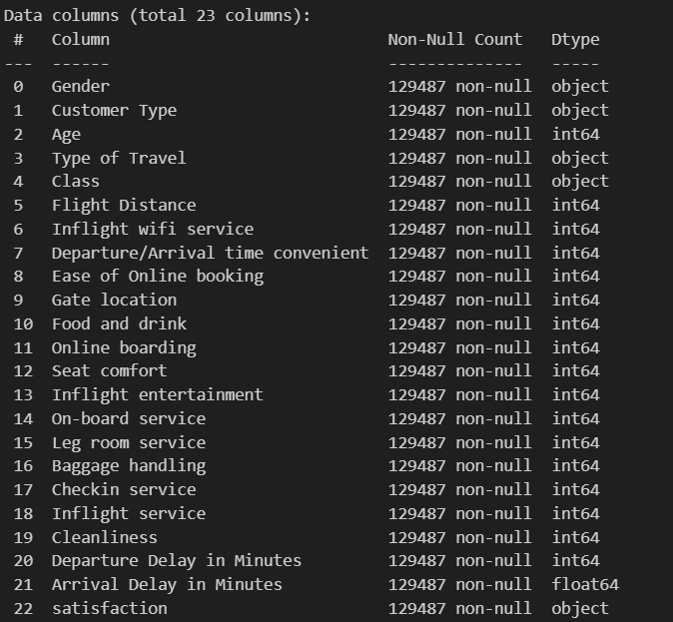
Data Frame

Slide 5

Data Cleaning
Null value handling
Feature encoding

Slide 6
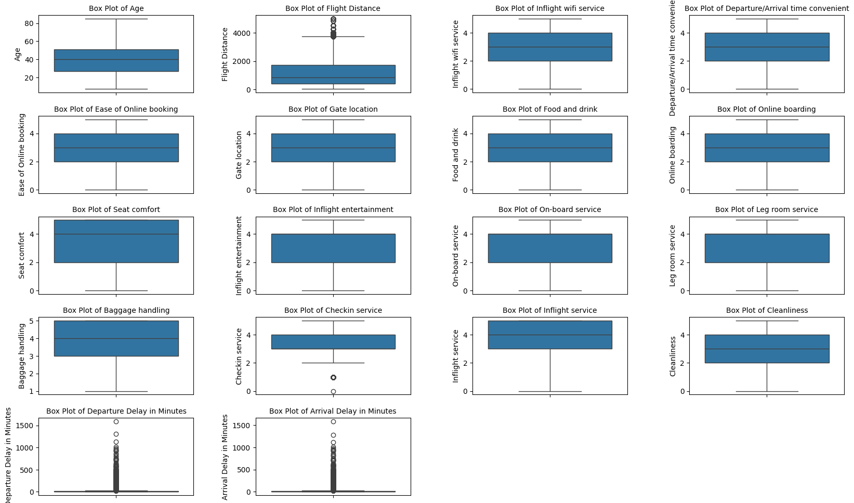
Data Cleaning: Outlier Removal
Before

Slide 7
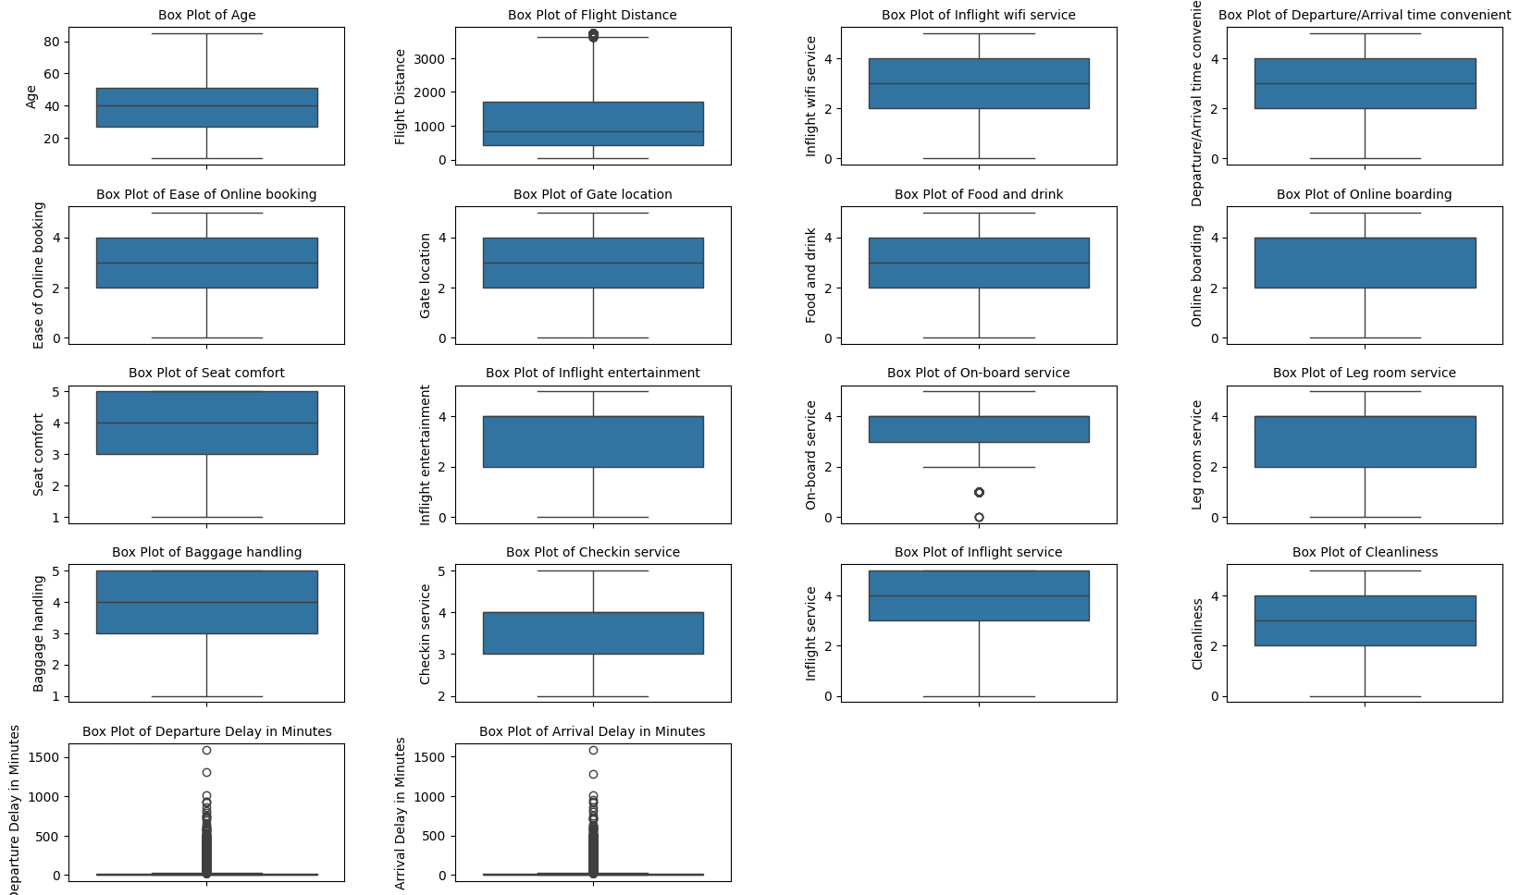
Data Cleaning - Outlier Removal
After

Slide 8
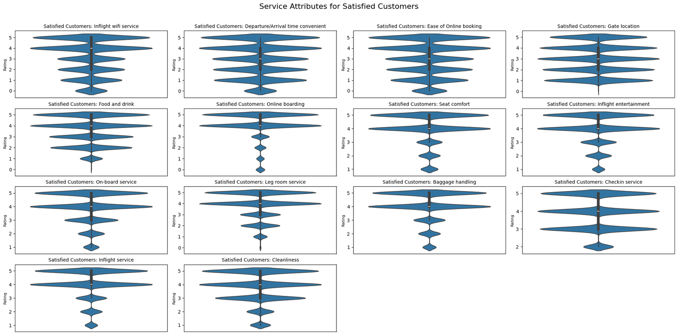
Most important reason for satisfaction
Service Attributes for Satisfied Customers

Slide 9
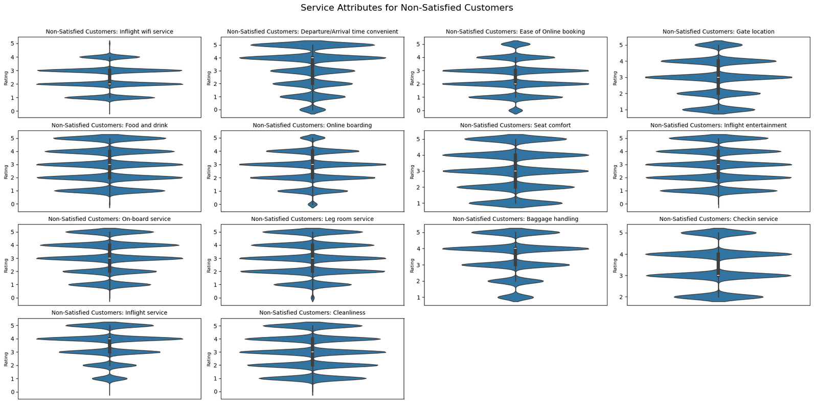
Most important reason for satisfaction
Service Attributes for Non-Satisfied Customers

Slide 10
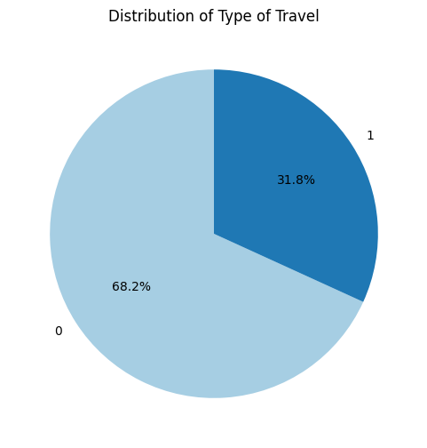
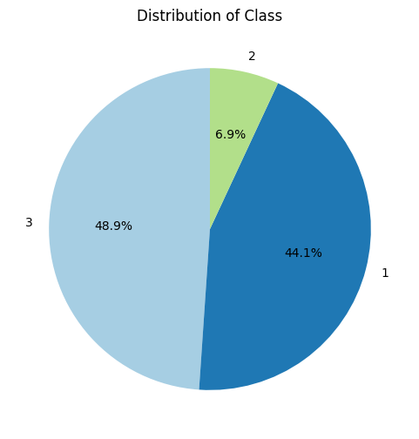
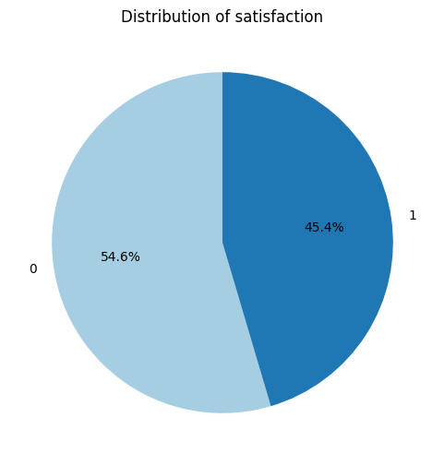
Type of Travelers, Class and Satisfaction Rates
Travel Type: 68.2% are Business Travelers.
Class: Business (48.9%) and Economy (44.1%) dominate; Economy Plus is minimal (6.9%).
Satisfaction: 54.6% dissatisfied, 45.4% satisfied.
Business - 0 Personal - 1
Economy - 1 Economy Plus - 2 Business - 3
Non Satisfied - 0 Satisfied - 1

Slide 11
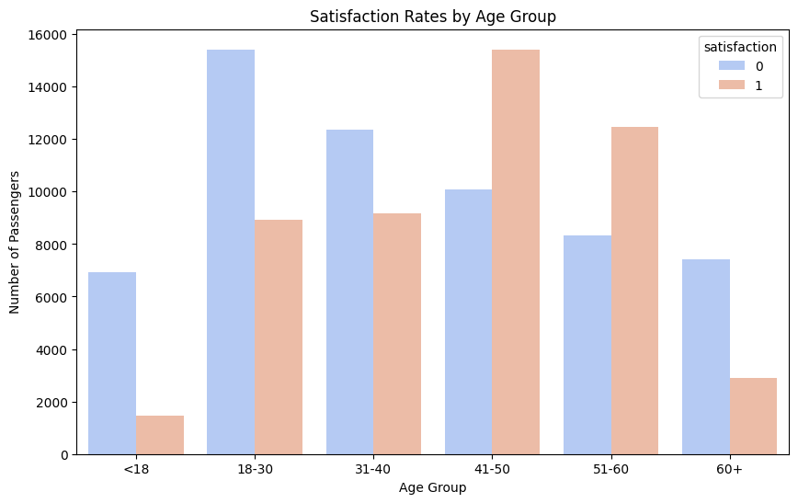
The Satisfaction and Dissatisfaction Rate for Different Age Groups
Non Satisfied - 0
Satisfied - 1
Age 18-30: Highest dissatisfaction.
Age 41-50: Highest satisfaction.

Slide 12
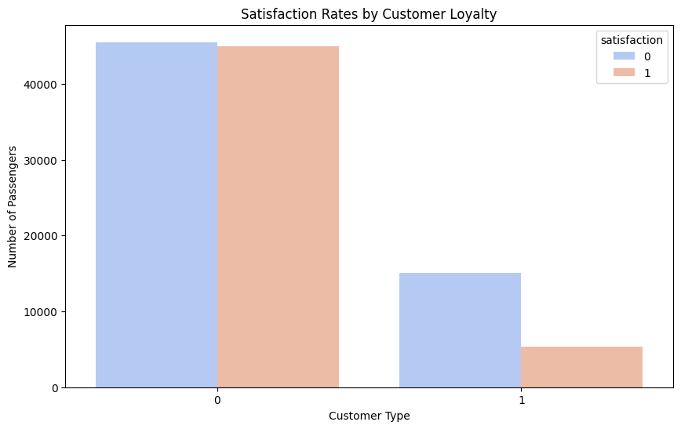
The Satisfaction between the Loyal and Disloyal Customers
Non Satisfied - 0
Satisfied - 1
Dissatisfaction is significant for both loyal and disloyal customers.
Loyalty's impact on satisfaction is unclear.
Loyal - 0 Disloyal - 1

Slide 13
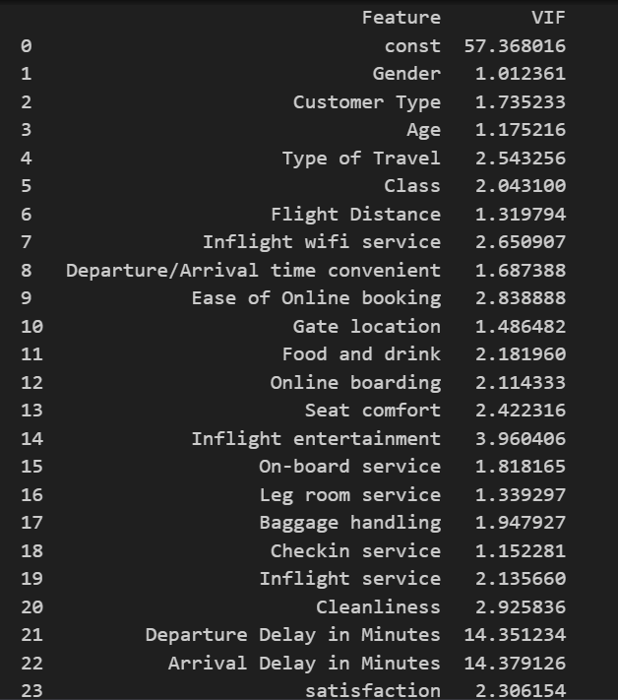


Slide 14
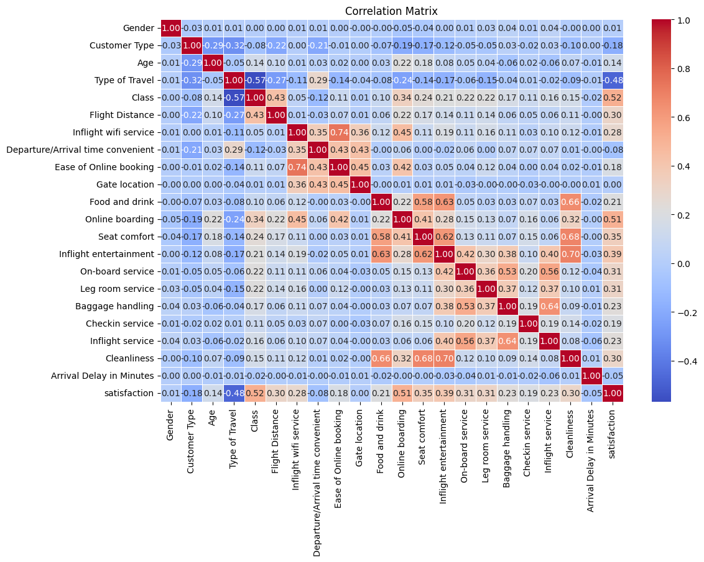
Correlation Plot

Slide 15
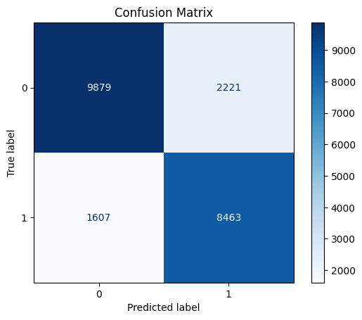
Logistic Regression Model:
Training set size: 88680 (80%)
Test set size: 22170 (20%)
Features:
'Class'
'Online boarding'
'Type of Travel'

Slide 16
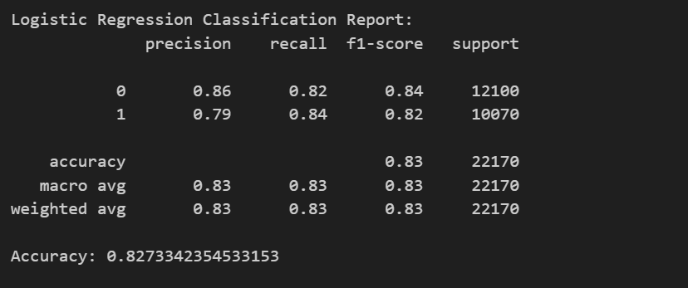

Slide 17
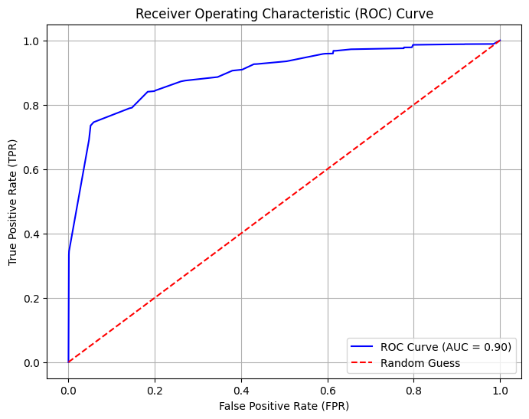

Slide 18
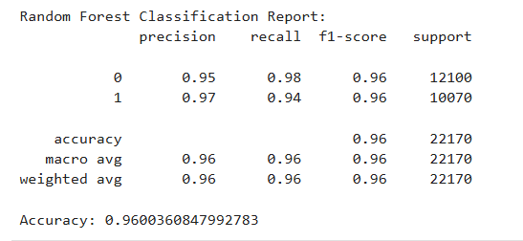
Random Forest Classification
Random Forest demonstrated strong classification performance with an accuracy of 96%.
Lets Interpret the Results !

Slide 19


Confusion Matrix
Train and Test Accuracy
The model is over-fitting

Slide 20
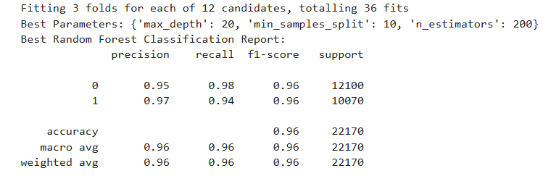
Hyperparameter Tuning
Cross validation score
Train and Test Accuracy

Slide 21
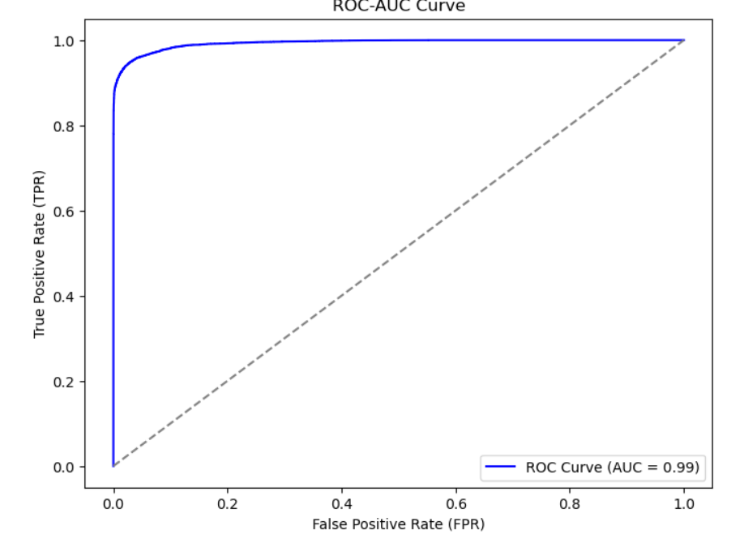
ROC -AUC Graph

Slide 22
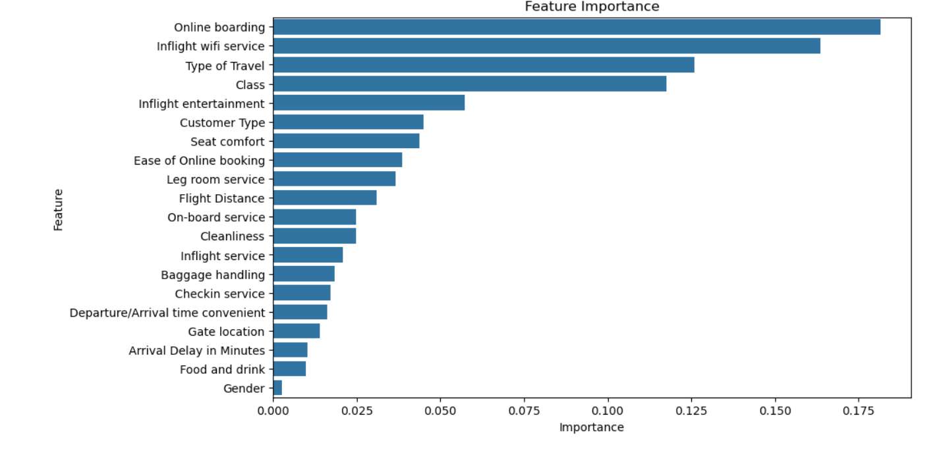
Feature Importance

Slide 23

Conclusion
The features that highly influence the Model are:
Online boarding
Inflight wifi service
Type of travel
Class
Comparing both the models performances it is evident that Random Forrest Classification is the better model in predicting the customer satisfaction.

Slide 24
Thank you

